Slide 1
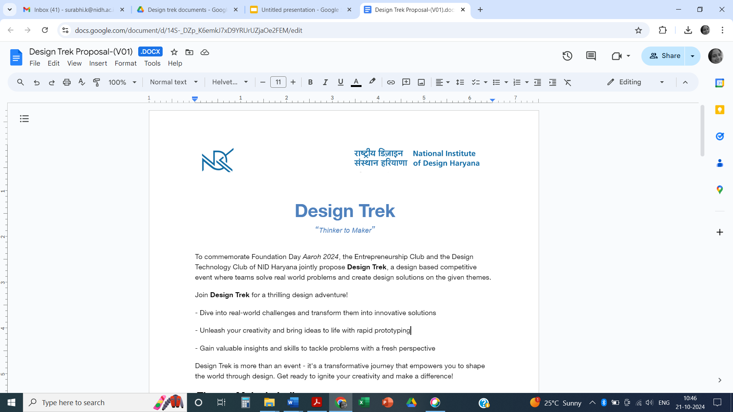
P.E.R.C.Y
Travel and transportation
By : Parantap Mishra, Varun Arora, Ekaksh Goyal, Pranav Verma
Lotus Valley International School, Noida
Grade 11

Slide 2
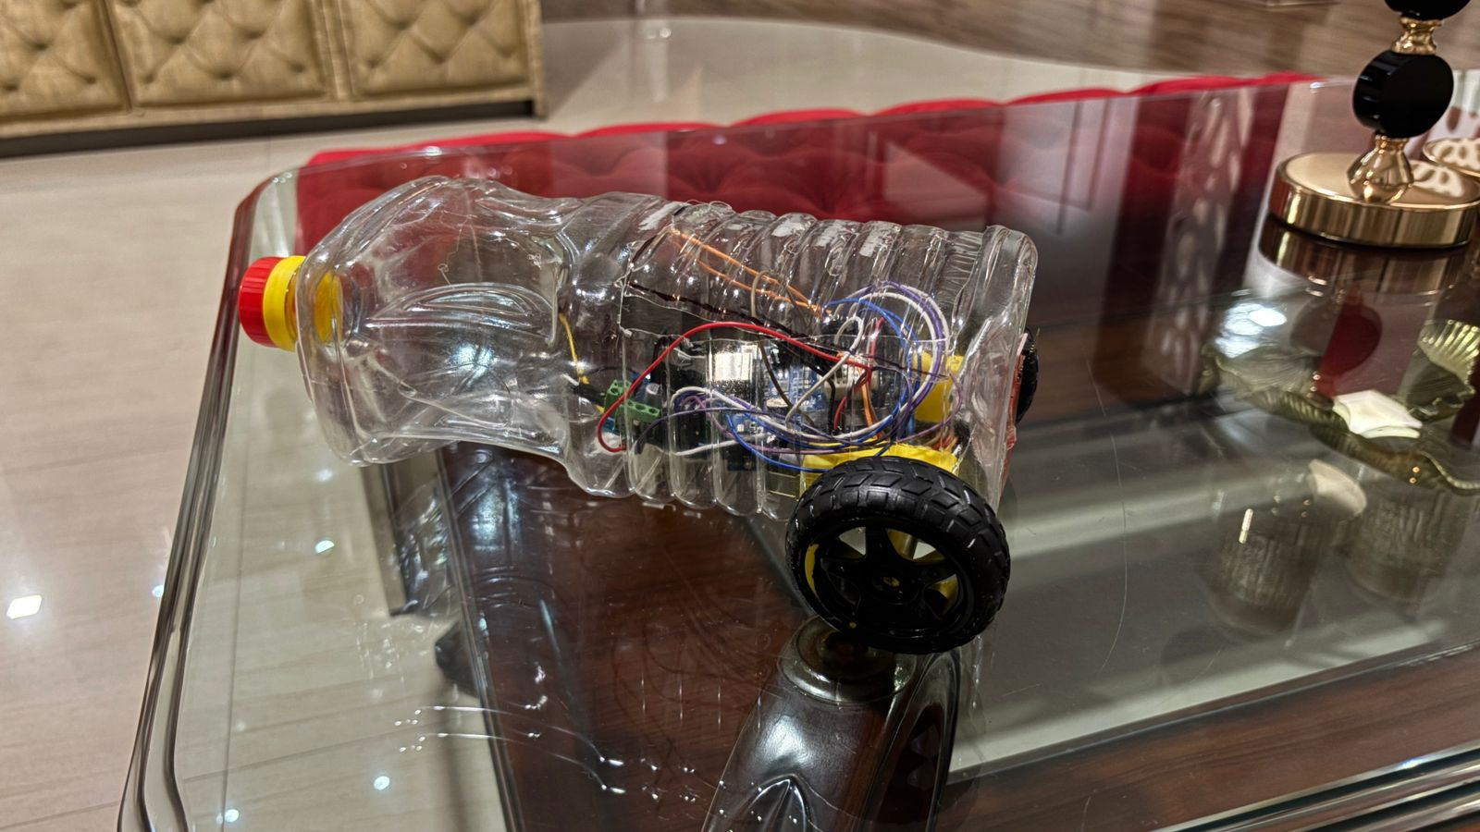
Project Brief
The intent behind P.E.R.C.Y is to create a practical, accessible solution for flood-prone areas, where heavy rains and rising water levels frequently disrupt daily life and endanger communities. We aim to address this issue by developing a modular, amphibious vehicle attachment that transforms regular cars into versatile, water-capable vehicles.
Our goal is twofold: First, to enhance safety and mobility during flood events, allowing individuals to navigate through submerged roads without relying solely on emergency services; and Second, to design P.E.R.C.Y as an affordable and scalable product that can reach and benefit as many people as possible, reducing transportation disruptions, and supports continuity even in adverse weather events.
Beyond immediate usability, P.E.R.C.Y is also intended to inspire innovation in disaster response and personal mobility. This aligns with our mission to make technology-driven, problem-solving solutions accessible to those who need them most, especially in communities where traditional flood-response resources may be limited.

Slide 3
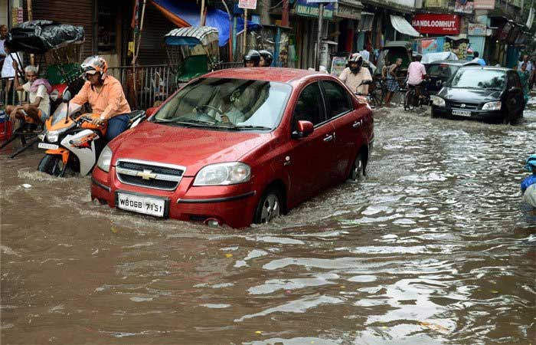
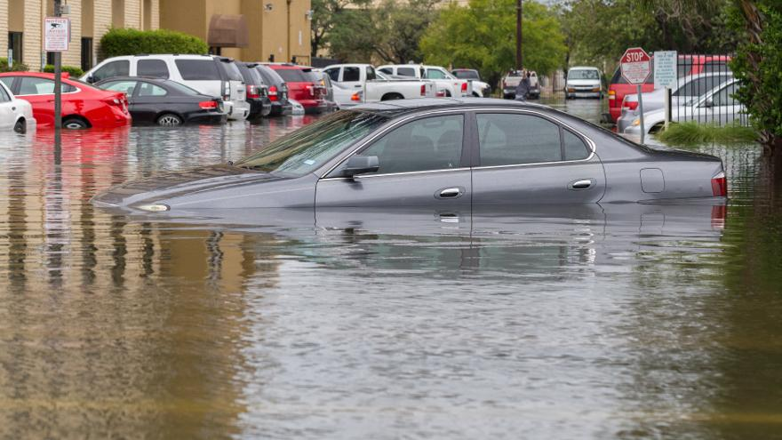
Research
Recent research has shown that floods and cyclones can cause significant damage to vehicles and transportation infrastructure in India.
Problem Statement Research:
A study by the National Disaster Management Authority found that the 2018 Kerala floods damaged over 100,000 vehicles, including cars, motorcycles, and trucks.Another study, by the Centre for Science and Environment, found that the 2019 Cyclone Fani caused damage to over 50,000 vehicles in Odisha. The study also found that the cyclone caused widespread damage to roads, railways, and other transportation infrastructure, making it difficult for people to get to safety. Another example of vehicles being destroyed by floods in India is the 2019 Chennai floods. These floods caused widespread damage to property and infrastructure, including vehicles. According to a report by the Tamil Nadu government, over 50,000 vehicles were damaged in the floods.
Design Research:
Designing the ideal spokes for Percy’s tires took us several weeks of extensive research and experimentation. We wanted to create a propulsion system that would maximize the vehicle’s efficiency in water while maintaining stability and control. Through a series of tests and design iterations, we discovered that the spokes needed to be curved, similar to the motion of a swimmer’s hands pushing water back to generate forward movement. After careful analysis of water dynamics and tire mechanics, we refined the angle and curvature of the spokes to create a paddle-like effect that efficiently propels the vehicle forward while minimizing drag.

Slide 4
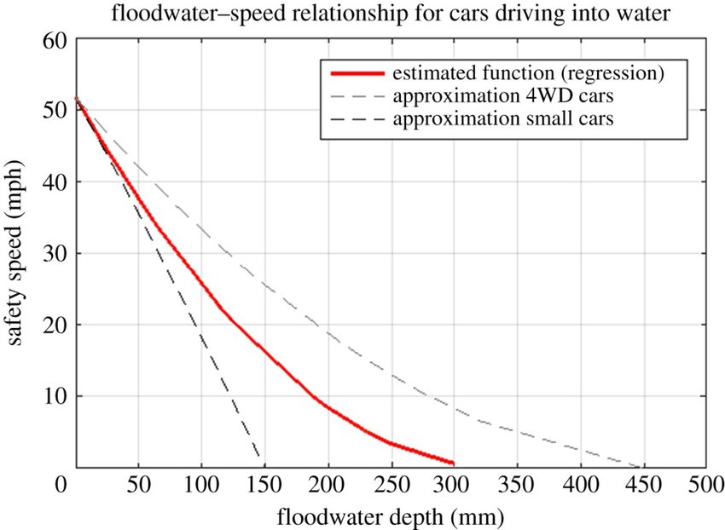
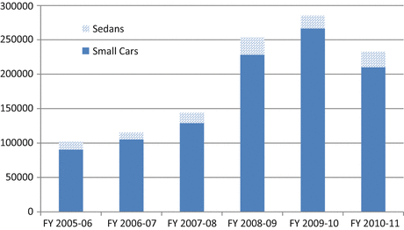
Problem Identification
The problem we identified is the increasing impact of floods on urban areas in India, where rising water levels disrupt daily life, damage infrastructure, and create dangerous conditions on the roads. Despite advances in disaster management, transportation remains severely compromised during floods, limiting people’s mobility and increasing their reliance on emergency services.
Flooded roads not only endanger people who attempt to drive through them but also isolate entire communities, delaying critical services and emergency response. This lack of safe, practical mobility options during floods is a pressing issue, especially as climate change intensifies rainfall patterns, making such events more frequent and severe.
We recognized that while amphibious vehicles exist, they are costly and inaccessible to the average individual or family. This led us to focus on a solution that makes flood-resilient transportation available to regular car owners in an affordable, attachable form. P.E.R.C.Y addresses this gap, providing a modular attachment that enhances standard vehicles to safely navigate both land and water during flood conditions.

Slide 5
Solution
The concept centers on an attachable module that can be easily fitted to existing vehicles, enabling them to function safely on both land and water when roads are submerged. This approach makes P.E.R.C.Y accessible, cost-effective, and versatile, allowing more people to prepare for and navigate through flood conditions.
P.E.R.C.Y’s functioning relies on an interconnected system of sensors, inflatable structures, and, in future iterations, specialized propulsion mechanisms.
Depth sensors are positioned on the vehicle to monitor the surrounding water levels.
Once these sensors detect that the water level has risen above a threshold, P.E.R.C.Y’s system activates the “Riptide mode,” alerting the driver and initiating safety measures.
The inflatable tubes, which are stored compactly around the vehicle’s frame, are then deployed. These tubes expand, creating buoyancy that allows the car to float above the submerged road. The inflatable tubes are strategically designed to ensure stability and balance in water, so the vehicle maintains a level position as it moves.
In future models, P.E.R.C.Y will include customized tires with paddle-like spokes that will aid in propulsion, allowing drivers to control their speed and direction in water with greater ease. These spokes will adjust based on the vehicle’s needs, offering enhanced movement capability in flooded conditions.
In essence, P.E.R.C.Y leverages straightforward yet powerful technologies to adapt standard vehicles for water travel in flood-prone areas, offering people a safer and more dependable option when faced with unexpected flood conditions.

Slide 6
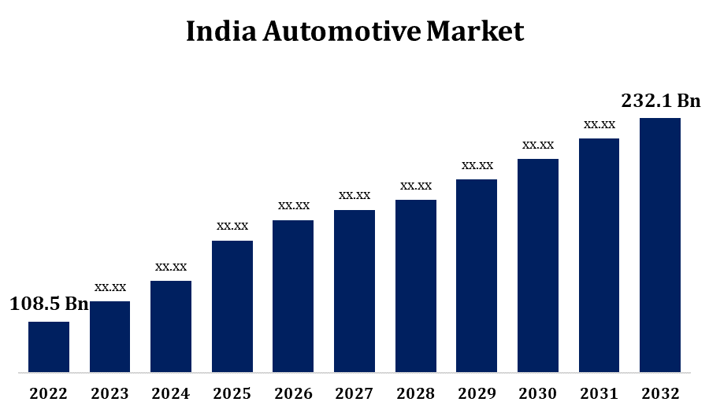
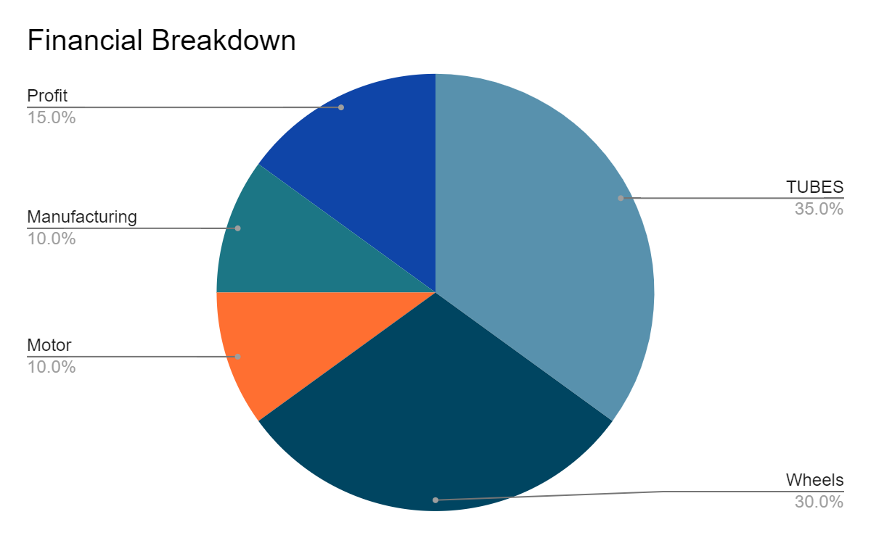
Execution
Feasibility of P.E.R.C.Y
P.E.R.C.Y’s feasibility stems from its use of proven, accessible technologies such as depth sensors and inflatable tubes, which are already utilized in automotive and emergency equipment fields. This ensures that its components are reliable and cost-effective for mass production. Designed as a modular attachment, P.E.R.C.Y is adaptable to multiple car models, making it a practical solution that doesn’t require extensive customization or complex installation. These factors contribute to its scalability and durability, essential for real-world application in flood-prone areas.
Commercial Potential of P.E.R.C.Y
P.E.R.C.Y addresses a significant market gap by offering an affordable, adaptable solution for flood-resilient transportation. Unlike fully amphibious vehicles, which are costly and limited to niche markets, P.E.R.C.Y’s attachable module is a viable option for individual car owners and organizations in flood-affected regions. Its potential partnerships with disaster management agencies, NGOs, and automotive manufacturers could expand its reach, making it an impactful, commercially viable product that empowers communities to navigate safely during floods.

